Slide 1
Digital Thinking and Innovation
Agile and Digital Thinking

Slide 2
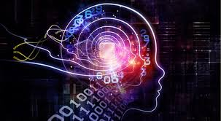
Introduction
This topic discusses how agile and digital thinking is used influences the business today

Slide 3
Learning Outcomes for the Lecture
At the end of this lecture you will be able to:
Define agile thinking
Identify the characteristics of agile mindset
Explain what is meant by digital thinking
Understand how agile thinking and digital thinking are used in the digital era

Slide 4
Content
Agile Thinking
Agile Mindset
Digital Thinking
Case Study

Slide 5
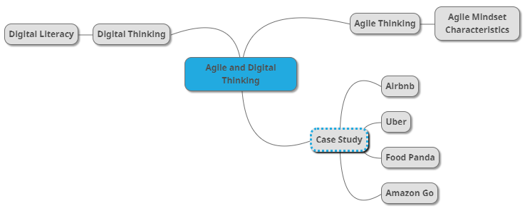
Mind Map

Slide 6
Learning Outcomes for the Lecture
At the end of this lecture you will be able to:
Define agile thinking
Identify the characteristics of agile mindset
Explain what is meant by digital thinking
Understand how agile thinking and digital thinking are used in the digital era

Slide 7
Design Thinking and Agile in Practice
“Innovation is no longer just about new technology per se. It is about new models of organisation. Design is no longer just about form anymore but is a method of thinking that can let you to see around corners. And the high tech breakthroughs that do count today are not about speed and performance but about collaboration, conversation and co-creation.”
– Bruce Nussbaum

Slide 8
Agile Thinking
Agile Thinking is the way of thinking which enables the ability to respond to change or solve problems quickly and easily
Take everything as lessons
Adjust actions according to the feedback
Proceed toward desired outcomes, resulting in continuous improvement

Slide 9
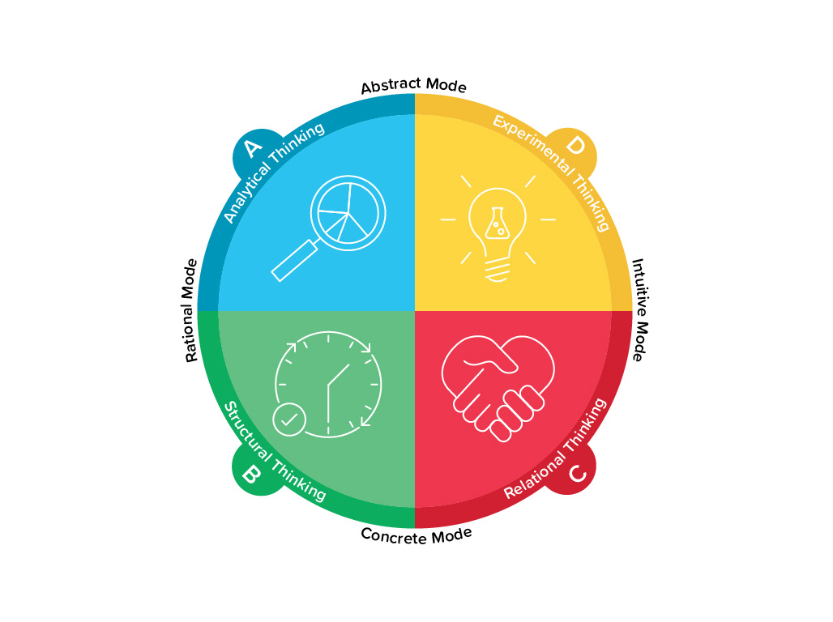

Slide 10
Learning Outcomes for the Lecture
At the end of this lecture you will be able to:
Define agile thinking
Identify the characteristics of agile mindset
Explain what is meant by digital thinking
Understand how agile thinking and digital thinking are used in the digital era

Slide 11

Agile Mindset
Several characteristics to make up the agile mindset:
Positive attitude
Thirst for knowledge
Goal of team success
Pragmatism
Willingness to fail

Slide 12
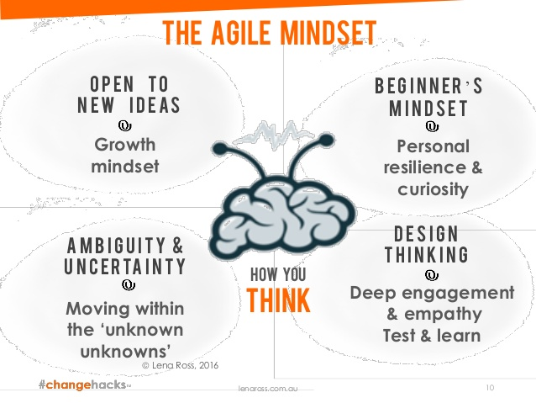
The Agile Mindsets

Slide 13
Learning Outcomes for the Lecture
At the end of this lecture you will be able to:
Define agile thinking
Identify the characteristics of agile mindset
Explain what is meant by digital thinking
Understand how agile thinking and digital thinking are used in the digital era

Slide 14
Digital Thinking
A refinement of the term digital literacy, describing the variety of thinking skills that comprise digital literacy
Digital literacy refers to an individual's ability to find, evaluate, and compose clear information through writing and other media on various digital platforms

Slide 15
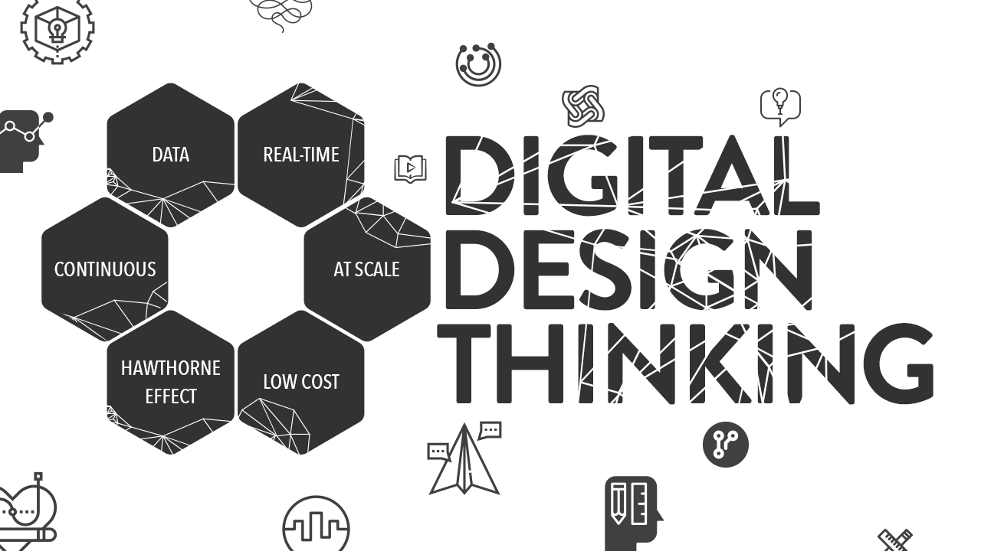
Digital Design Thinking

Slide 16
Learning Outcomes for the Lecture
At the end of this lecture you will be able to:
Define agile thinking
Identify the characteristics of agile mindset
Explain what is meant by digital thinking
Understand how agile thinking and digital thinking are used in the digital era

Slide 17

Airbnb Case Study
Watch this video: https://www.youtube.com/watch?v=1Tc9YScMtN8
Article: https://www.growthmanifesto.com/airbnb-growth-strategy

Slide 18
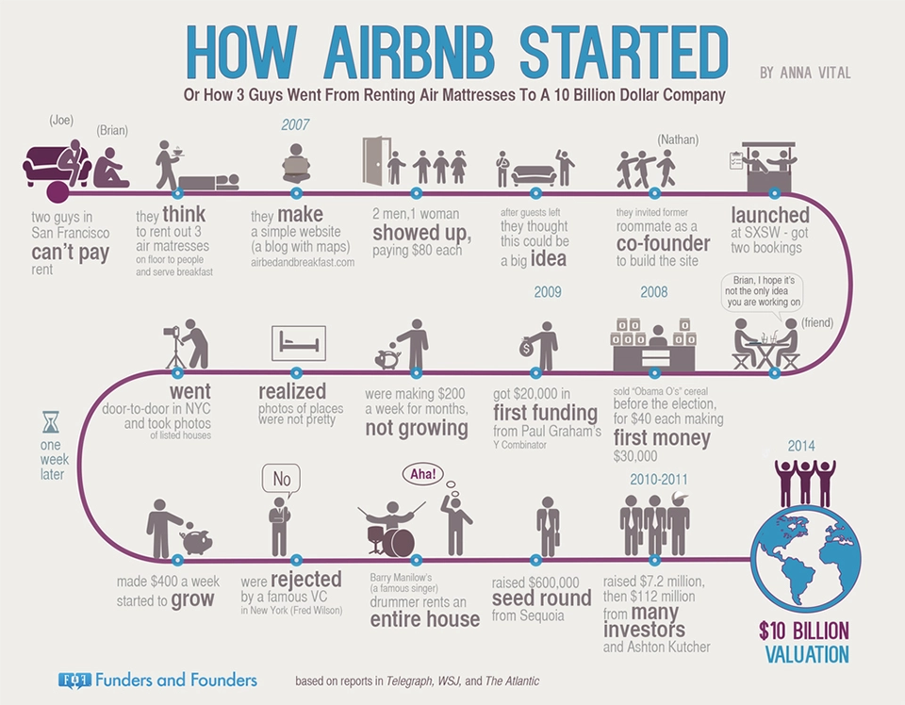

Slide 19
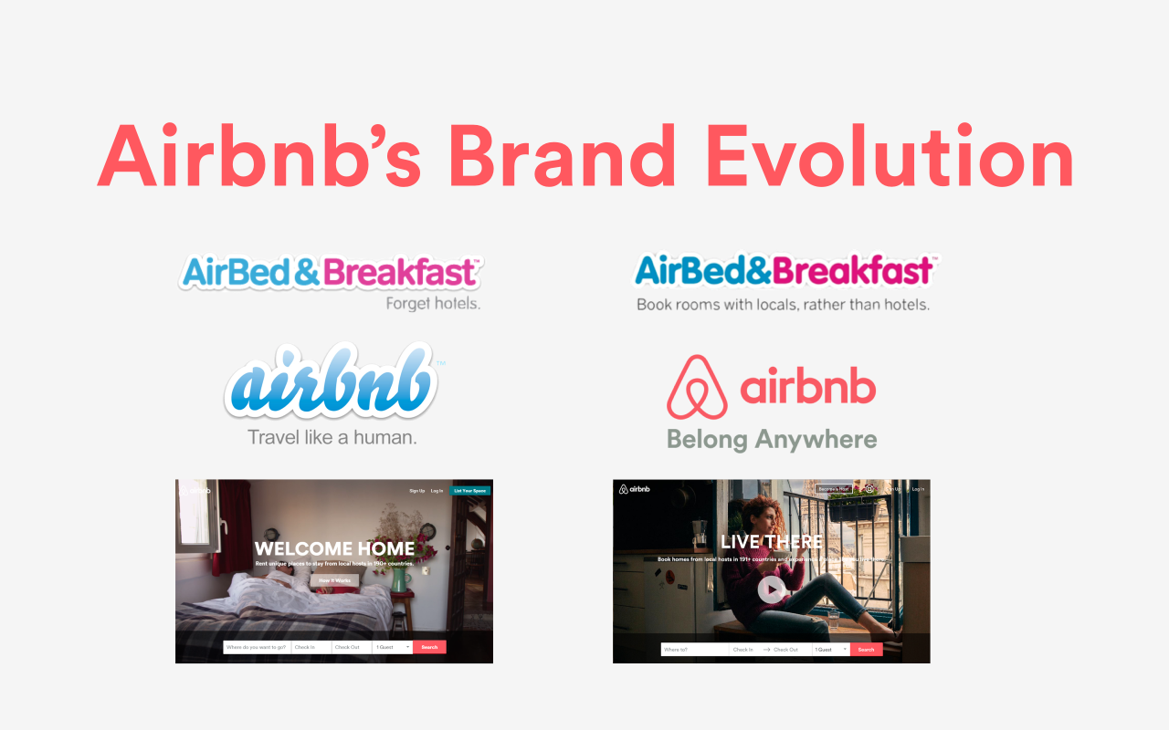
Airbnb: The Product
How does Airbnb position itself differently to stand out from other accommodation booking engines?
How has Airbnb diversified the product range to ensure they keep growing?

Slide 20
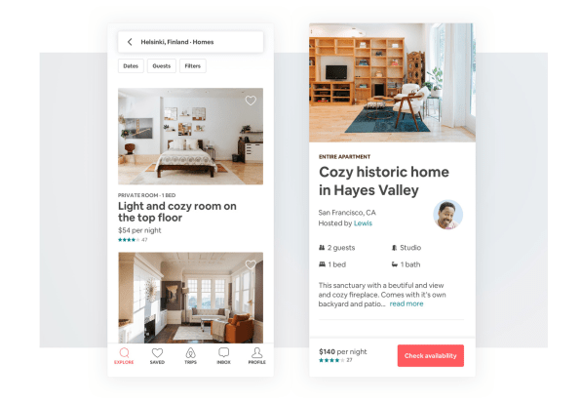
Airbnb: The Website/App
How does Airbnb use personalization to produce more relevant pages for users?
How does it gear the product pages towards making a sale?

Slide 21

Airbnb: Marketing and Social Media
How does Airbnb use articles and videos to keep the guests and hosts engaged with the platform?
How does Airbnb use Facebook, Instagram, and Twitter to build and convert an audience of guests and hosts?

Slide 22
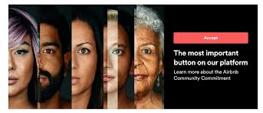
Airbnb: Community
How does Airbnb maintain and grow its online community?
What part does community play in their business growth?

Slide 23

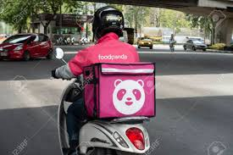
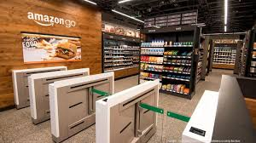
Case Study
Other examples include:
Uber
Food Panda
Amazon Go

Slide 24

Group Discussion
Watch and discuss the content of the video:
https://www.youtube.com/watch?v=NrmMk1Myrxc&feature=youtu.be

Slide 25
Summary
Agile Thinking and Mindset
Digital Thinking
Technologies

Slide 26
Questions and Answer
Q & A

Slide 27

Next Lecture
Digital Culture and Society

